Slide 1
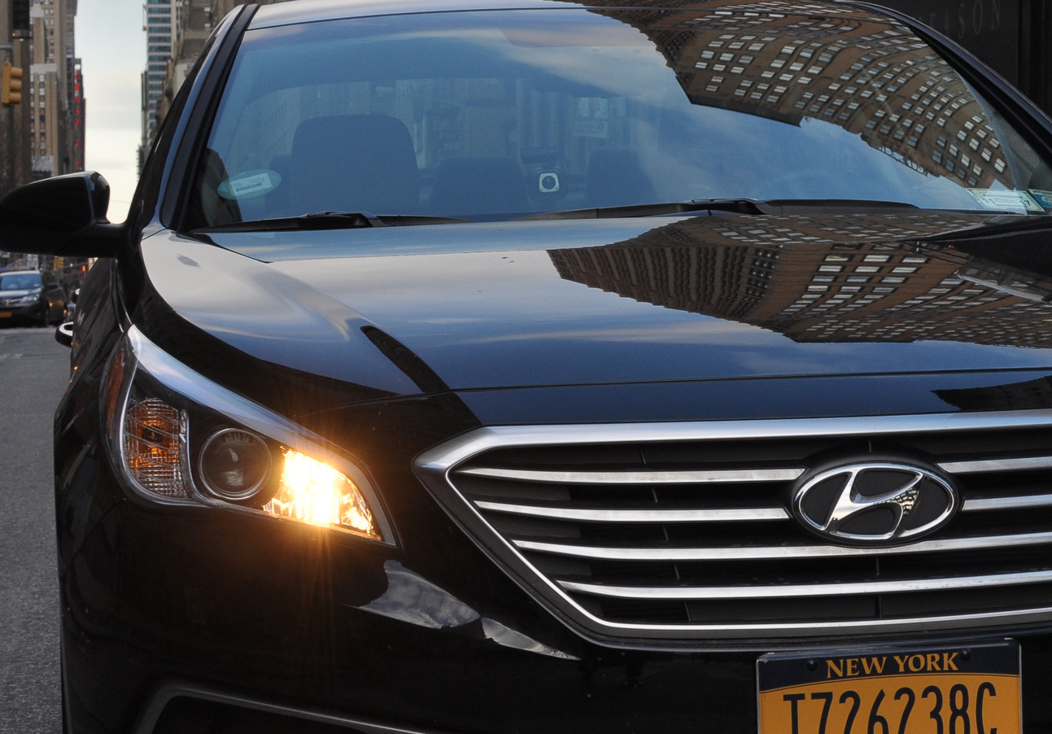
The Road to Shared Autonomous Vehicles
Bruce Schaller
Principal, Schaller Consulting
April 25, 2017

Slide 2
View this in Powerpoint Slide Show mode, and just click through
The Road to Shared Autonomous Vehicles
As tech firms and auto makers begin to test and look toward introducing fully autonomous vehicles, transportation, environmental and energy leaders are eagerly anticipating the replacement of private autos with systems of shared autonomous vehicles.
A system of shared autonomous vehicles (SAVs) holds the promise of saving lives, eliminating traffic congestion, increasing mobility, and reducing space devoted to parking in central cities.

Slide 3
The Road to Shared Autonomous Vehicles
While much of the discussion of SAVs is necessarily speculative and based on sometimes-arcane travel demand modeling, there is much to be learned about the path toward SAVs from current experience with Uber, Lyft and other app-based ride services.
The key lessons fall into two broad categories …

Slide 4
From these, we need to have …
BIG CONVERSATION
What customer is saying
What math is showing

Slide 5
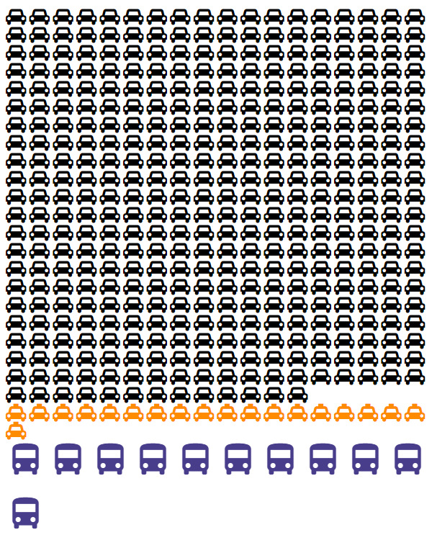
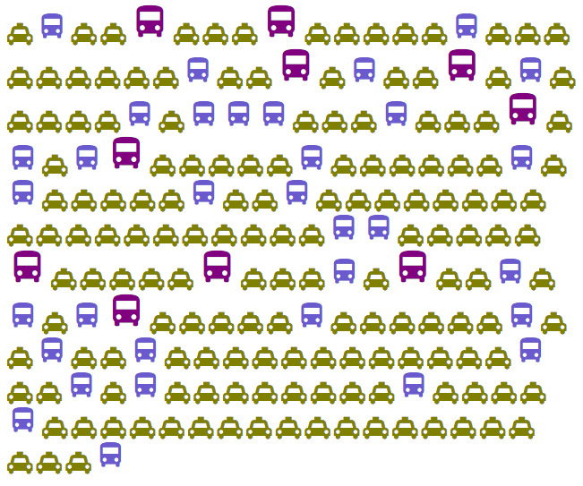
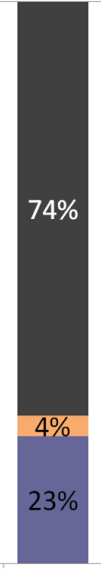
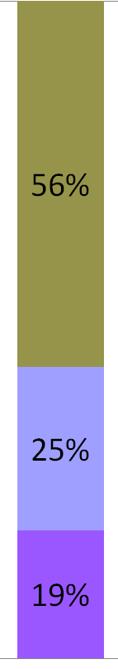


Shared Autonomous Vehicle Future
Today
With Shared AVs
Mode shares
The SAV vision moves from today’s auto-dominated society, to a system of vastly fewer SAVs that are safer, cheaper, more efficient and less polluting.
Shared
taxi
Auto
Taxi
Taxi-
Bus
Transit
Based on OECD/Int’l Transport Forum Lisbon model

Slide 6
Path forward involves transitioning from …
Planning- centric
Market- Driven
Technology (AV & EV)
Demand models
Consumer benefits
Customer choice
Quality/Price/Selection
“Find the market”

Slide 7
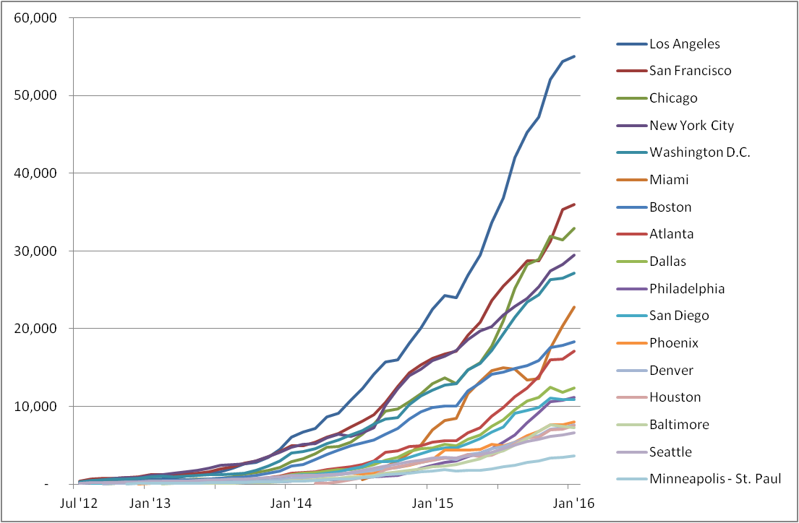
Rapid growth of Uber, Lyft and other Transportation Network Companies (TNCs) are showing what customers want and value.
Consumers are Showing the Way
# Uber Drivers Making at Least 1 Trip/month
Source: Uber

Slide 8
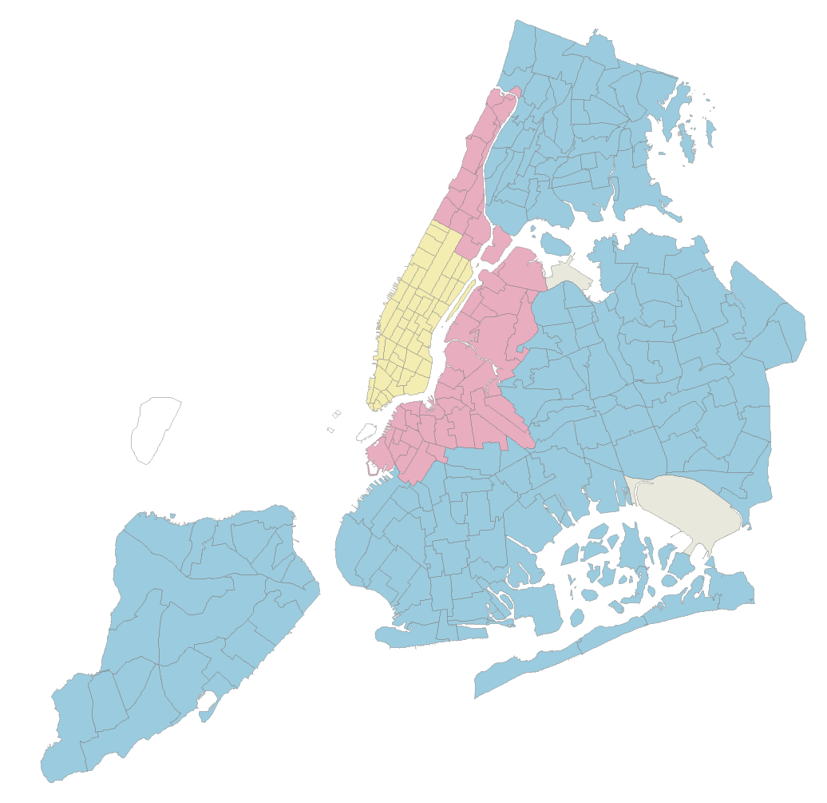
My research in New York City shows how TNCs fill gaps and deficiencies in the existing transport sector.
Trip growth mainly outside Manhattan due to
lack of yellow cabs
23%
or readily-available car services
33%
37% of overall TNC/taxi trip growth
Transit often slow, unreliable or circuitous
Combined Taxi & TNC trips
Change from 2013 to 2016

Slide 9
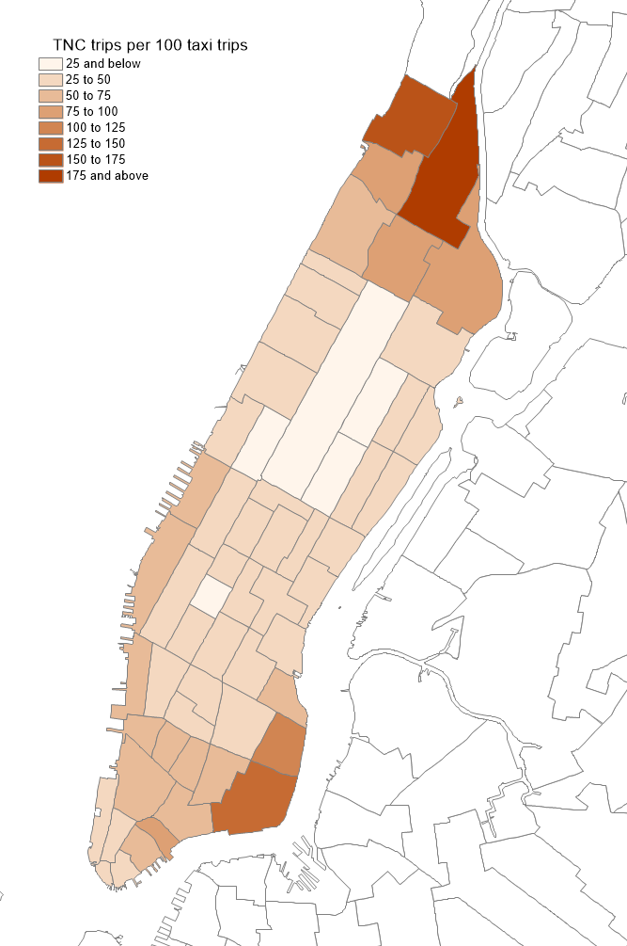
In Manhattan, TNCs fill gaps in:
Peripheral areas
TNC trips per 100 Yellow Cab Trips
Weekdays, 2016

Slide 10
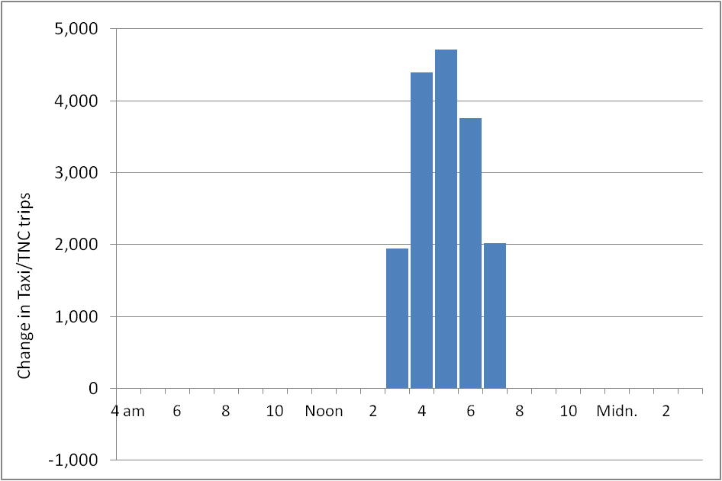
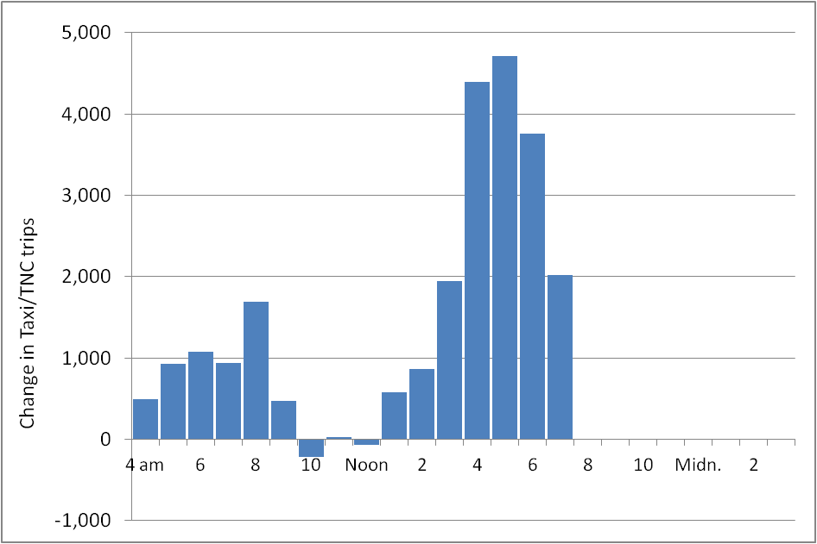
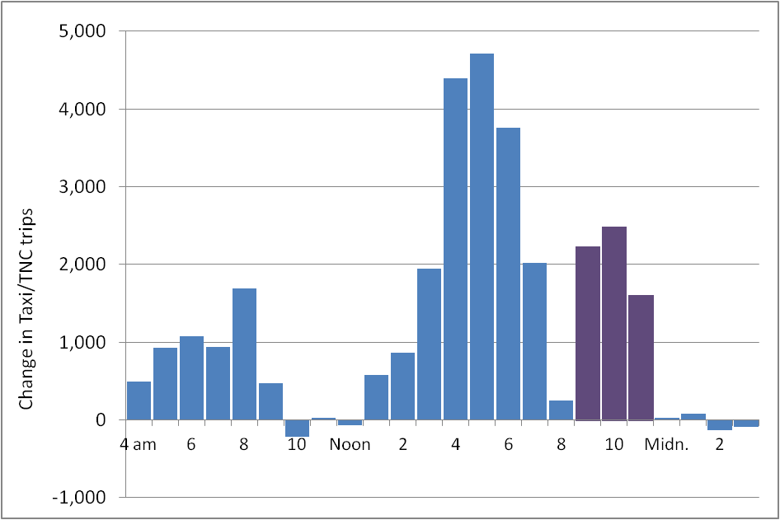
Afternoon peak
(yellow cab shift change)
Evening: Quick/ comfortable alternative to subway
Growth in average weekday trips, Manhattan
2013 to 2016

Slide 11
Common themes:
Save time
Customer is saying
Reduce stress

Slide 12
The Road to Shared Autonomous Vehicles
TNCs save time and reduce stress -- making them a great and even overdue additional option that is very beneficial to the customer.
That said, TNC growth also raises issues related to congestion, emissions and transit impacts…

Slide 13
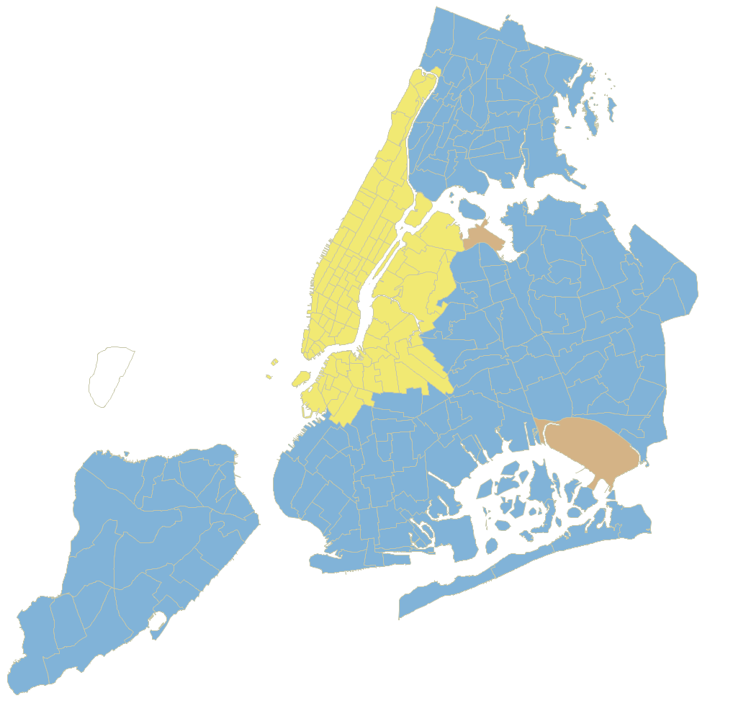
Large increases in vehicle mileage
Citywide
600 million miles
3.5% of VMT
Congested core:
353 million miles
7% of VMT
Increase in taxi/for-hire vehicle mileage
2013 to 2016

Slide 14
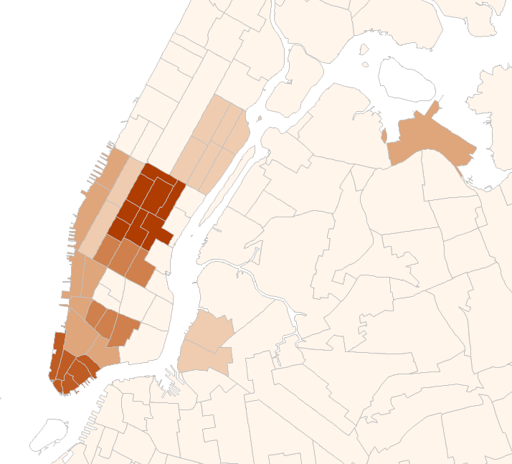
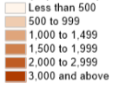
Large increases in trips during PM peak
Weekdays, 4 - 7 pm
TNC increase net of decline in yellow cab trips, per hour per sq. mile
Change in taxi/TNC trips
2013 to 2016

Slide 15
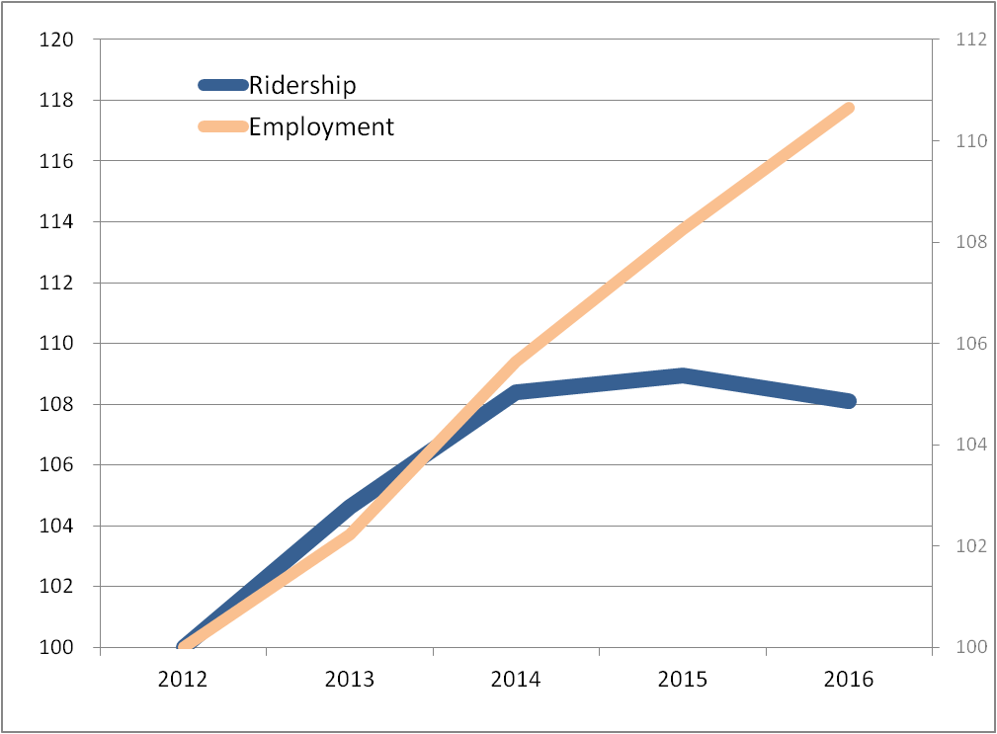
Subway ridership declining despite economic growth
Many reasons for this, from crowding that is product of years of ridership growth to need for capital renovations.
New York
TNCs provide option for subway riders fed up with crowded, slow and unreliable service.
I estimate about 1/3 of gap on this chart is related to people switching to TNCs

Slide 16
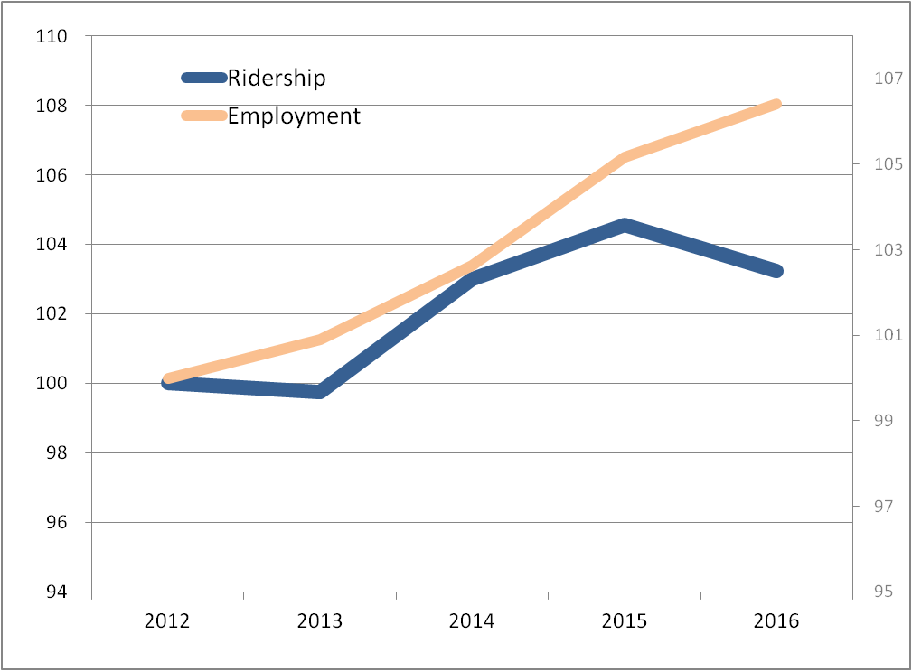
Similar trends are seen in other big cities:
Chicago

Slide 17
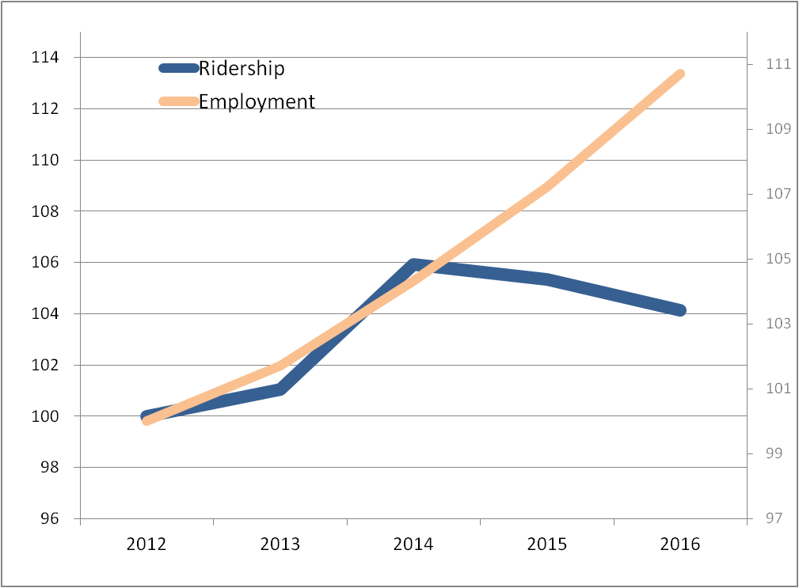
Boston

Slide 18
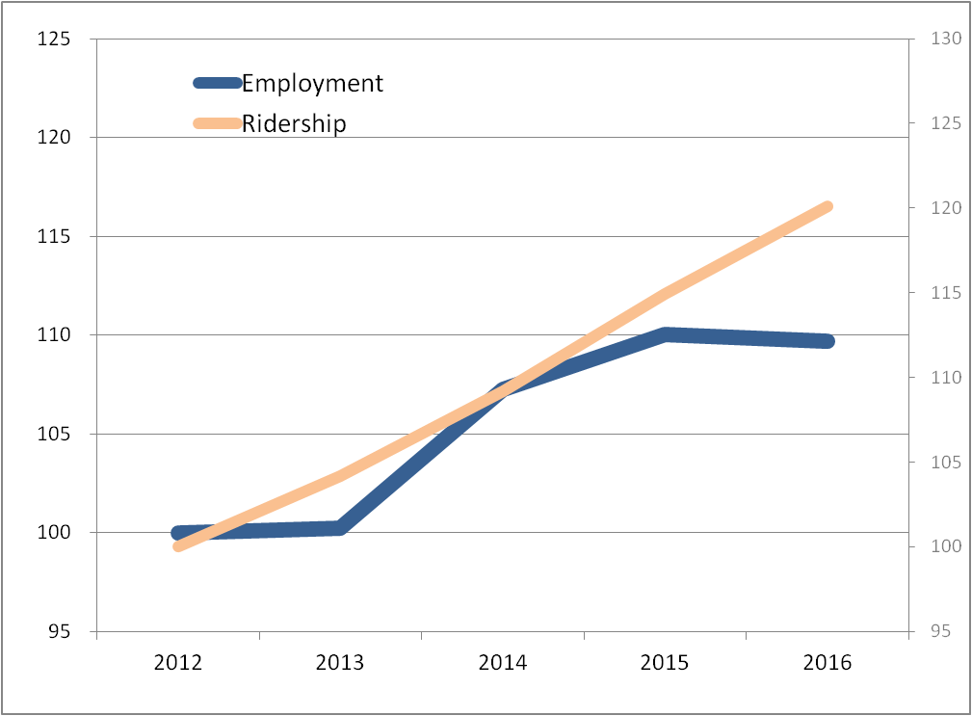
San Francisco

Slide 19
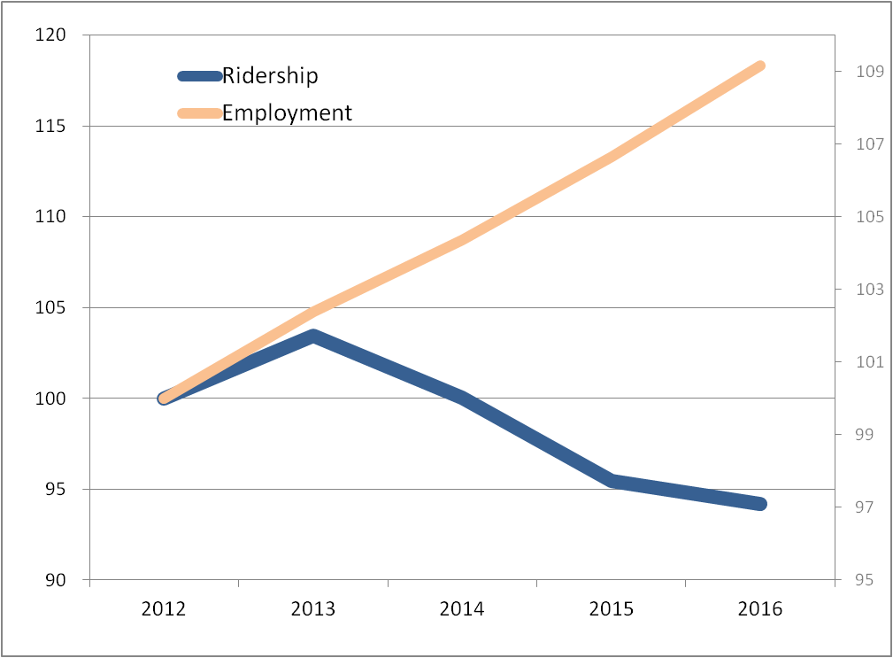
Los Angeles

Slide 20
Why TNC growth becomes a traffic and emissions problem:
Popularity of TNCs Leading to
Shift to Smaller Vehicles
AUTO
SUBWAY
Average: 27.3
TAXI
TNC (more pooling)
LIGHT RAIL
TNC
Average: 23.1
BUS
Average: 12.9
What the math is showing

Slide 21
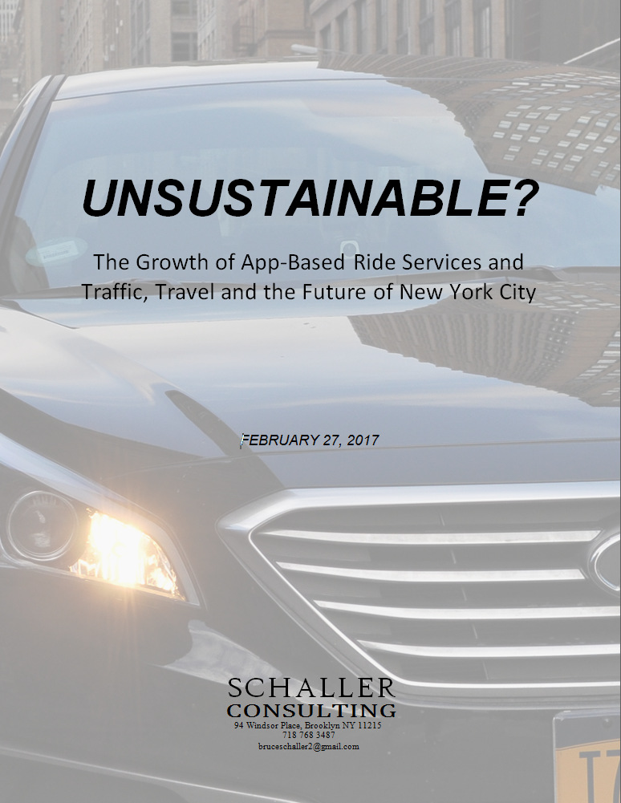
Immediate steps, detailed in this report, can help transit compete effectively with TNCs.
How to Help Transit Now
Subway reliability and capacity (CBTC)
Bus speeds
(off-board fare collection, bus lanes, traffic signal timing)
Road pricing
(charge low-efficiency
vehicles)

Slide 22
Looking further ahead:
SAV Future Lies in
Space-Efficient Vehicles
Premium Ride Services
High Capacity Transit
Large Network of Shared Electric Autonomous Vehicles

Slide 23
SAV Future Lies in
Space-Efficient Vehicles
Fixed Route/
Fixed Schedule
Taxi/TNC
What is Service Model?
Exclusive ride
On-demand
Route deviation
Premium fares
Point-to-point
Sedans/SUVs
?
Shared ride
Scheduled
Fixed route
Low fares
Walk to pickup
40-foot buses/
rail cars
What is Business Model?
What Public Policy Gets There?
We know how this service works
And how this works too

Slide 24
What we need to have is:
Big Conversation
If we don’t have a big conversation, what we may well get is:
Gold
Rush
Fed/state/local government
TNCs
Tech companies
Auto makers
Communities
Driven by intensive competition aimed at claiming market share
Government role focused on safety
Shared vision for outcomes
Deeply informed by data
Transit operators trail far behind
Private sector
Experimentation
Fast failure
Policy responses are fragmentary & problem-driven
Traffic
Safety
Equity
Nimble public policy response
Adaptive response by legacy public and private services

Slide 25
The Road to Shared Autonomous Vehicles
It’s our choice.

